Slide 1
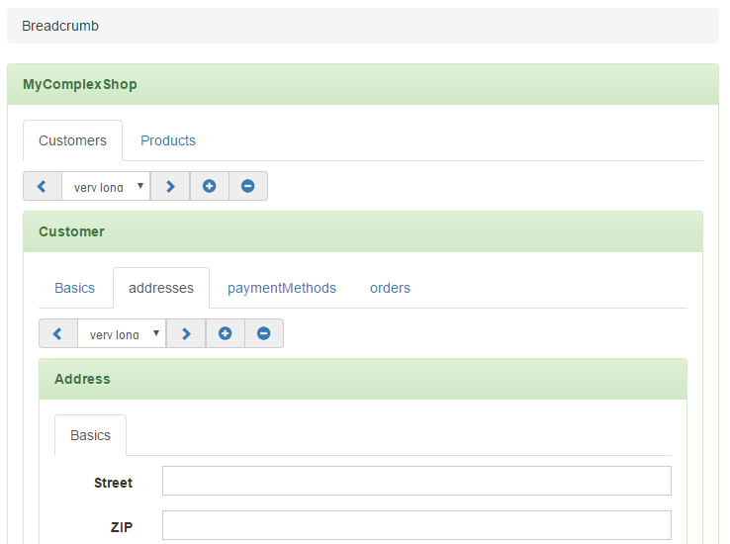

Slide 2
Eleny Task 1:
Move list control into panel heading
Customers
<
Joe Doe
>
+
-
Eleny Task 2:
Create new row with
Label („Joe Doe“)
Comments-Icon + Badge(„4“)
History-Icon + Badge („6“)
Joe Doe
4
6
Basics
Adresses
Others

